Slide 1

Trivalley Bike Customer Average Monthly Spending and Likely Buyer Using Predictive Analytics
Tuba Meric

Slide 2

CONTENT
Business Case
To predict customers' monthly spend and whether a customer will be buying a bike or not
Data Acquisition
Customers’ past monthly spends, yearly income, age, education, occupation, marital status and location data was obtained in CSV format
Data Preparation
Missing data was found using dataprep package on Python
Building and Training Model
Predictive ML models were build using Pycaret & H2O python libraries utilizing Regression and Classification algorithms for predictions
Data Visualization
Graphs were created using Tableau to understand factors impacting customer monthly spending and whether a customer would buy a bike or not

Slide 3
Data Preparation
Total number of records = 16519
98 duplicate records found
Following missing values were found:
Title: 16431 (99% of the total records)
Middle Name: 6985 (42% of the total records)
Suffix: 16517 (99.9% of the total records)
Address Line 2: 16243 (98% of the total records)
Missing values treatment:
Title (16431 records): Since 16431 records out of 16519 are missing which is >20% we will not use this feature on the analysis.
Middle Name (6985 records): Since 6985 records out of 16519 are missing which is >20% we will not use this feature on the analysis.
Suffix (16517 records): Since 16517 records out of 16519 are missing which is >20% we will not use this feature on the analysis.
Address Line 2 (16243 records): Since 16243 records out of 16519 are missing which is >20% we will not use this feature on the analysis.
Other Consideration
An ‘Age’ variable was created from the ‘BirthDate’ variable using the datetime python library to consider the impact of age on AveMonthSpend and BikeBuyer variables.

Slide 4
Exploratory Data Analysis
The Features (i.e., variables) are segregated into three Categories
Independent Variables
Predictor Variables
(y)
Noise Variables
Variables which does not have
significant impact on Predictor variable
Data which is to be predicted
Variables which were considered to have
an impact on the Predict or variable

Slide 5
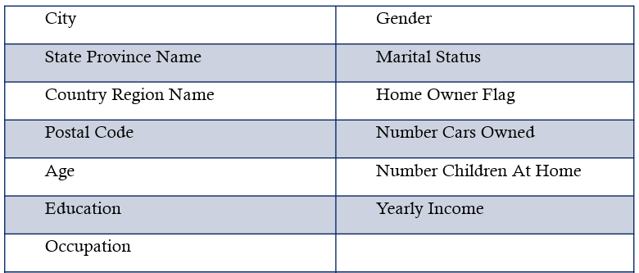
Exploratory Data Analysis
Noise Variables
Predictor Variables

Slide 6
DATA VISUALIZATION
Data visuals are created using Tableau where charts are plotted using the independent variables against the dependent variable (Std Score).
These charts help us in getting a preliminary idea about the relationship between the independent variables and the dependent variable (Std Score).

Slide 7
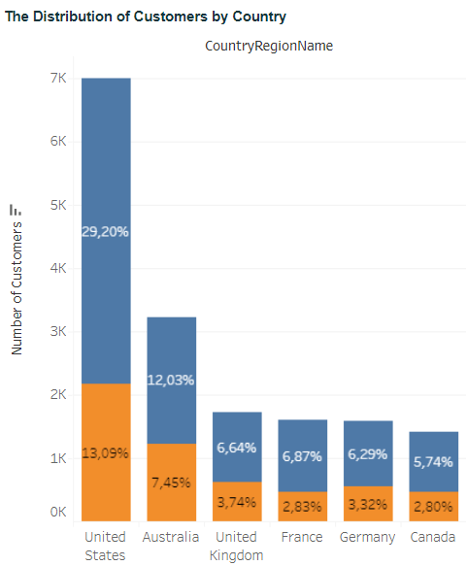
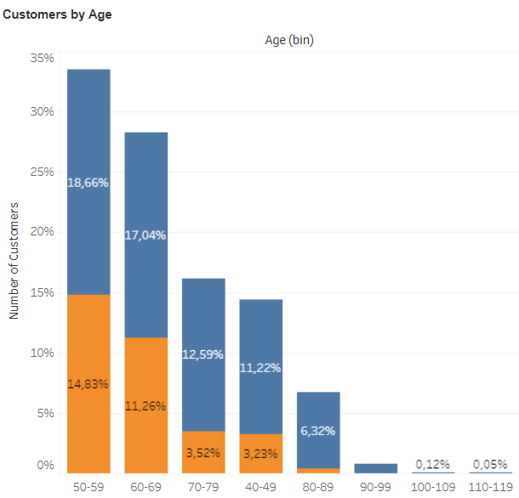
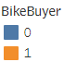
Bıke Buyers By Countrıes and Ages
Key Highlights
The biggest number of bike buyers is in the United States and the lowest is in Canada.
People between 50-59 years old are the biggest population prefer using bike.

Slide 8
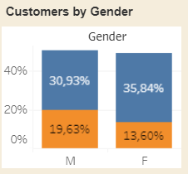
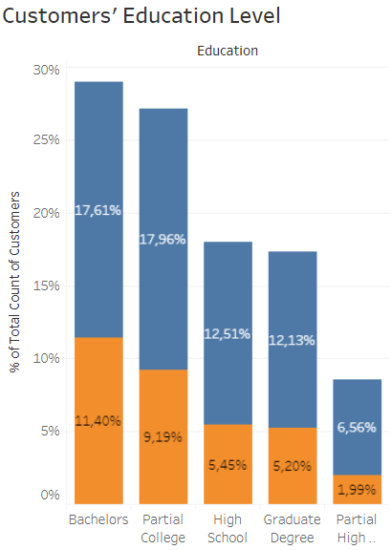
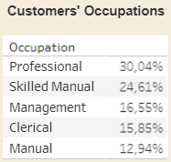
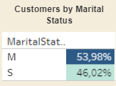
RelatıonshIp between Customers’ DemographIcs and BIke Buyers
Key Highlights
Males buy bikes slightly more than females and married people buy bikes more than single people.
People with higher education and Professional job owners buy more bikes than others.

Slide 9
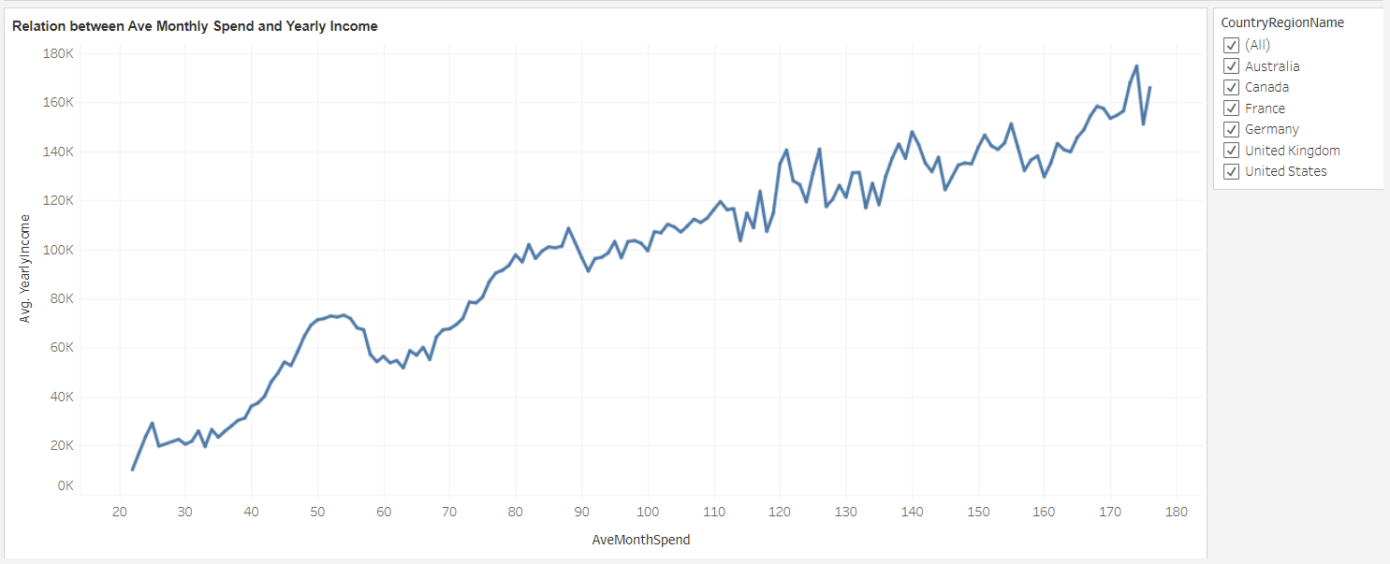
RelatIon Between Average Monthly Spend and Yearly Income
The chart shows that as yearly income increases, average monthly spend also increases.

Slide 10
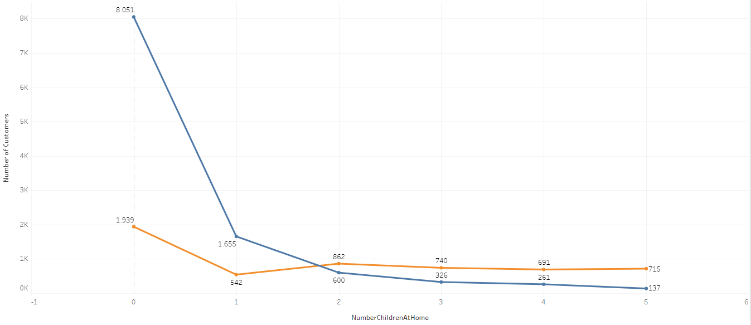
RelatIonshIp between Number of ChIldren and BIke Buyers
Key Highlights
There is no relation between the number of children at home and bike buyers.

Slide 11
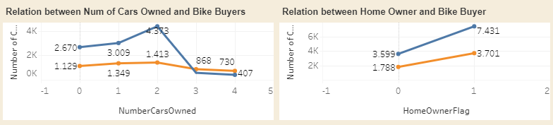
RelatIon between Number of Cars Owned/Home Owner and BIke Buyers
Key Highlights
There is no relation between the number of cars owned and bike buyers.
Higher percentage of home owners prefer to use bikes more than non-home owners.

Slide 12
ALGORITHMS AND MACHINE LEARNING
ML Algorithms and Algorithm Selection
Confusion Matrix
Chi-Square Test Analysis

Slide 13
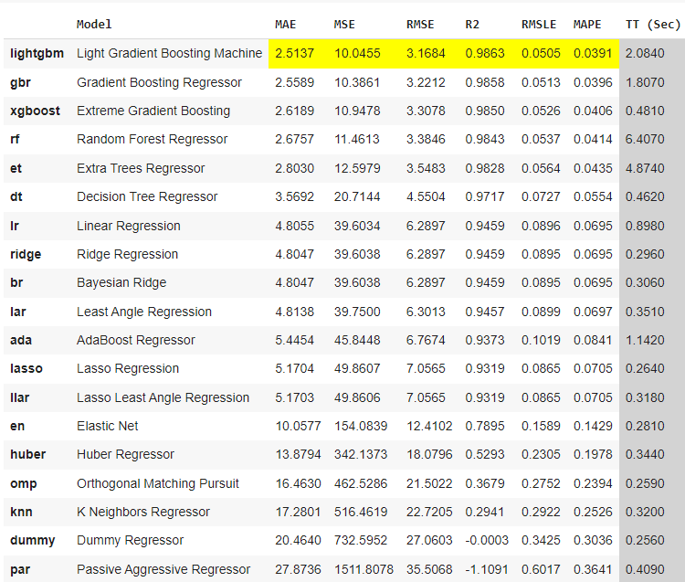
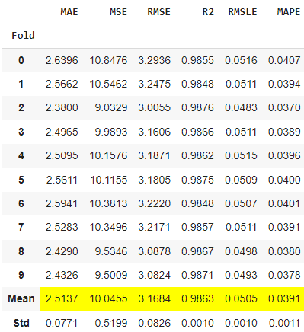
Algorıthm selectıon for average monthly spend
Comparison of ML Algorithms
Metrics for Light Gradient Boosting Machine

Slide 14
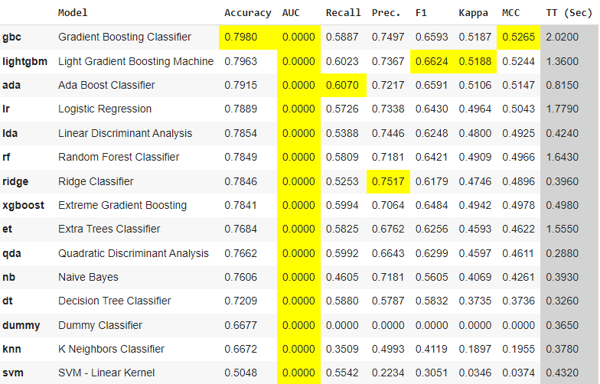
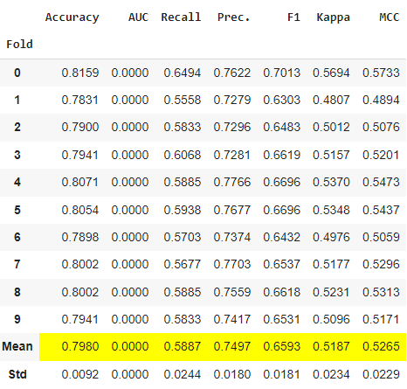
Algorıthm selectıon for bıke buyer
Comparison of ML Algorithms
Metrics for Gradient Boosting Classifier

Slide 15
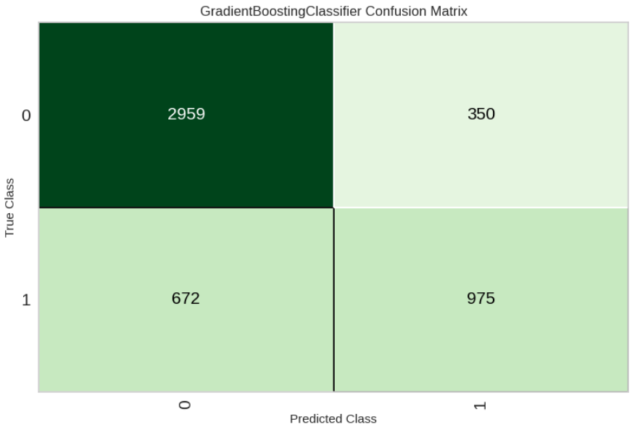
Confusıon matrıx from gradıent boostıng classıfıer
Not Bike Buyer
Bike Buyer
Correctly Predicted as Not Bike Buyer
Falsely Predicted as Bike Buyer
Not Bike Buyer
Falsely Predicted as
Not Bike Buyer
Correctly Predicted as Bike Buyer
Bike Buyer
Key Highlights
Actual number of customers who were Non_BikeBuyer = 3,321 and BikeBuyer = 1,635
A total of 4,956 predictions were made by the model in the confusion matrix.
Out of the total predictions, the model made 1,260 predictions as BikeBuyer and 3,696 prediction as Non_BikeBuyer
The model correctly predicted 2,986 customers as Non_BikeBuyer, and 925 customers as BikeBuyer
The model falsely predicted 710 customers as Non_BikeBuyer and 335 customers as BikeBuyer
Higher percentage of home owners prefer to use bikes more than non-home owners.

Slide 16
BIke Buyer Chi-Squared Test Analysis
Chi-Squared Test Analysis was performed to identify list of features which impact the std score
Top 3 Categorical features impacting the Bike Buyers Std Score
1. Number of Children at Home
2. Number of Cars Owned
3. Marital Status
Top Numerical features impacting the Bike Buyers Std Score
1. Yearly Income
2. Age
Least impacting features on Bike Buyers Std Score:
Home Owner Flag, Country/State, Education, Gender, Occupation, Marital Status

Slide 17
BIke Buyers Linear Correlation Tests Analysis
Top 3 Influencing factors on AVERAGE STD SCORE of bike buyers are : Yearly Income, Number of Children at Home, Age
All the correlations are either weak or moderate.
Independent Variable | Correlation
Yearly Income | 0.29
Number of Children at Home | 0.17
Age | 0.14
Number of Cars Owned | 0.05
Marital Status | 0.03
Occupation | 0.03
Gender | 0.01
Education | 0.01
State Province Name | 0.01

Slide 18
Average Monthly Spend Chi-Squared Test Analysis
Chi-Squared Test Analysis was performed to identify list of features which impact the std score
Top 3 Categorical features impacting the Average Monthly Spend Std Score
1. Number of Children at Home
2. Gender
3. Number of Cars Owned
Top Numerical features impacting the Average Monthly Spend Std Score
1. Yearly Income
2. Age
Least impacting features on Average Monthly Spend Std Score:
Country/State, Education, Home Owner Flag, Marital Status, Occupation

Slide 19
Average Monthly Spend Linear Correlation Tests Analysis
Top 3 Influencing factors on AVERAGE STD SCORE of average monthly spend are : Yearly Income, Number of Children at Home, Age
All the correlations are either weak or moderate.
Independent Variable | Correlation
Number of Children at Home | 0.73
Yearly Income | 0.61
Gender | 0.57
Number of Cars Owned | 0.47
Occupation | 0.38
Marital Status | 0.22
Home Owner Flag | 0.13
State Province Name | 0.12
Education | 0.11
Country Region Name | 0.11
Age | 0.01

Slide 20
Questıons?
Contact Via:
twobameric@gmail.com

